Slide 1
Python Web Programming

Slide 2
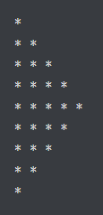
Question
Write a program to use the loop to find the factorial of a given number.
Write a program to print the following start pattern using the loop.
Write a program to iterate a given list and count the occurrence of each element and create a dictionary to show the count of each element.
— sample_list = [11, 45, 8, 11, 23, 45, 23, 45, 89]
— Printing count of each item {11: 2, 45: 3, 8: 1, 23: 2, 89: 1}
Remove special symbols from a string.

Slide 3
Function

Slide 4
Creating a Function
def my_function():
print("Hello from a function")

Slide 5
Calling a Function
def my_function():
print("Hello from a function")
my_function()

Slide 6
Arguments
def my_function(fname):
print(fname + " Refsnes")
my_function("Emil")
my_function("Tobias")
my_function("Linus")
Arguments are specified after the function name, inside the parentheses. You can add as many arguments as you want, just separate them with a comma.
The following example has a function with one argument (fname). When the function is called, we pass along a first name, which is used inside the function to print the full name.

